Slide 1
Healthy Partnerships:
Food Pantry Case Studies in Urban & Rural Settings
Liz Seefeldt
Executive Director
The BRICK Ministries, Inc.
director.thebrick@centurytel.net
Catherine Draeger-Pederson
Executive Director
Friedens Community Ministries, Inc.
director@friedenspantry.org
Notes:
Welcome to Healthy Partnerships. I’d like to introduce my colleague, Catherine D-P, Exec. Dir. of Friedens Community Ministries, in Milwaukee. I’m Liz S., ED of The BRICK Ministries, in Ashland on Lake Superior. A few housekeeping items before we begin if any. I ask that we all agree that specifics of our conversations remain confidential. It’s important for us to have a safe place to share details about our programs without fear that those details will be discussed where it might not be appropriate. I encourage you to share what you’ve learned today, and yet ask we’re all discrete with specifics that might be considered sensitive in nature.
Catherine and I are here to share our own experiences in operating our food shelf programs in contrasting rural and urban settings. We’ll describe our individual programs, discuss differences and similarities of our pantry programs, and focus on how we contribute to the health of our communities.

Slide 2
Meeting community food security and health needs regardless of setting
The BRICK Ministries, Inc.
Friedens Community Ministries, Inc.
Rural
Remote
Sparsely populated
Close knit community
Urban
Proximate
Densely populated
Anonymity
Community Depression
Values Based Service Delivery
Wisconsin Office of Rural Health: http://worh.org/WisRuralAreas
For more information on Frontier Areas: see Rural Health Information Hub: https://www.ruralhealthinfo.org/topics/frontier
Notes:
When Catherine and I initially compared our different circumstances, of course the first thing that jumped out was the rural vs. urban experience. What does that difference look like?
The BRICK’s service area is all of Ashland and Bayfield Counties. That’s a combined land mass of over 2,500 sq. mi., compared to Milw. Co.'s 240 sq. mi.
Total population in the two-county area is under 31,000 people vs. Milwaukee Co.'s nearly 1 million – give or take 40,000.
What does that number of people look like in such a spread out area? Population density is between 10 and 15 people per square mi. in our area, compared to over 3,900 people per sq. mi. in Milw. Co.
But it’s not just the number of people or the large land mass. The Wis. Office of Rural Health – an office of UW-Madison’s School of Medicine & Public Health – recognizes Ashland and Bayfield Counties as “Frontier” counties. Frontier areas are not just rural, they’re the uber-rural. Additional factors used to ID frontier areas include distance and travel time to reach population centers and services. Someone living in Barnes in the SW corner of Bayfield County has to drive about an hour to cover nearly 50 miles to reach the County seat of Washburn. And it’s another 20 miles to the northern most community of Cornucopia.
The kinds of services that would be assumed in an urban setting are often non-existent in a frontier region. I’m pleased to report that our local hospital is building a new cancer treatment center. However until it’s complete, people requiring chemotherapy have to travel 70 miles to Duluth for services.
The closest mall is an hour and a half away from Ashland.
Frontier communities also lack paved roads. My own municipality – the Town of Kelly – controls over 40 miles of roadways. Not one of them is paved with anything other than gravel. This is typical in our frontier counties.
Public transportation is limited to a few select routes, several of which run only once a day. Most of the two county area is not accessible by public transportation.
Some roads in outlying areas are only seasonally accessible and access to some services changes depending on the seasons. My local post office is only open half days.
Essential vehicles for northwestern WI? Your pick-up truck and your snowmobile!
Other things that define our rural community are the different demographics compared to Milw. Co.
While Milw. Co.'s main minority population is African American being over one-quarter of the total population, Ash & Bay Cos have nominal African American, Hispanic, and Asian populations. Our major minority population is Native American – at over 10%, compared to Milw. Co.'s at <1%.
While some would characterize our community as parochial – and they might be right – we prefer to describe ourselves as close knit. Close knit can mean watching out for your neighbor – but the downside is that everyone knows your business no matter how private you try to be. In a large city, it’s easy to stay anonymous, away from prying eyes, but perhaps falling off the radar of those who might care about you.
Certainly, there are significant differences between our two service areas.
But a few things are constant, no matter where we serve. One is the prevailing sense of an entire community’s depression. After decades or more of pervasive poverty and lack of opportunity, the community as a whole can’t but feel helpless and without hope.
The bright spot, however, is that no matter where we serve, not matter who we serve, our food pantry programs deliver services based on our core values, our mission, and our vision.

Slide 3

HISTORY & PROGRAMMING
Initial collaboration of 7 churches in 2007 has grown to 20 members in 2016
Food Shelf Outlets:
  Ashland – November 2007
  Cornucopia – July 2010
  Mellen – February 2011
  Cable – May 2011
  2007 – 990 people served/mo. 2015 – 1,615 people served/mo.
Benevolence Program
  2008 – 105 households/$16,000, 2015 400 households/$89,000
  Internal funds plus Salvation Army vouchers
Plateau at Toddlerhood
  Few evaluative tools
  Only generalized procedures, policies, processes
  Minimal self-analysis
  Nonprofit Lifecycle: http://www.501commons.org/engage/volunteer-resources/info/nonprofit-life-cycle
  http://prezi.com/fpwuozkeu_km/?utm_campaign=share&utm_medium=copy&rc=ex0share
Notes:
To help you understand how The BRICK ministries has grown and where it is headed, let me give you a brief history.
The BRICK Ministries started in 2007 as a collaboration of 7 churches. Leaders of those congregations saw a need and believed that they could do more collectively than individually.
Besides our food shelf program, The BRICK also offers emergency financial assistance for utility disconnections and overdue rent through our benevolence program. Starting out with a much smaller reach and scope, both programs have grown in terms of number of people served and the dollar value of the services provided.
In fact, overall our organization has grown to a membership of 20 congregations.
However, after our first few years of enthusiasm and growth, our organization stumbled and then stagnated.
What did that look like? For The BRICK it manifest in volunteers bringing their personal dramas into the workplace, staff sniping at volunteers, the ED dictating to the board, and board of directors merely looking at reports on a monthly basis. No one group of stakeholders was doing its best to provide services.
Our processes and procedures were only rough outlines. And we didn’t gather much data or use what we did gather to much purpose.

Slide 4
Engaging community for individual & collective health
Well run pantry program requires
  Quantity
  Quality
But first - HEALTHY IMPACT requires HEALTHY ORGANIZATION
Notes:
How CAN we do our best to provide services and make a healthy impact?
At face value, we can state that a well run pantry program must have adequate quantity to serve its constituents, and also high quality of service delivery.
All this can be quantified. We can count our output in # of people served, pounds distributed, pounds distributed/person, $ value of food distributed, # of volunteers, # of volunteer hours, # of service locations, %age of total population reached, etc., etc.
We can also quantify the quality of our services. We do that through outcomes evaluations such as satisfaction surveys and focus groups.
Then we use all those numbers to determine what kind of impact our program has on program participants and the community.
But how do we get to the point where you’re able to translate what we do and how we do it into data, and then evaluate our healthy impact?
To have a healthy impact our organization as a whole must be healthy.

Slide 5
Determine Needs and
Prioritize Goals
Willingness to admit deficiencies
ID areas for improvement
Initiate strategic planning
Emphasize essentials
  Mission and Vision
  Core Values
Follow-Through
The Seven Deadly Saying of Nonprofit Leaders. . .And How to Avoid Them, Reid A. Zimmerman, PhD, CFRE, R A Zimmerman Consulting
Notes:
The behaviors I described were clearly not healthy. The BRICK had stalled in a holding pattern and its leadership didn’t know how to jumpstart the organization.
We started by acknowledging that we could do better. This seems obvious, but it’s easy to fall into the trap of “we’re doing okay.”
But when we took an honest look inside, we found that there were plenty of areas for improvement.
The most prominent issue was staff turnover. In 2013 – which was The BRICK’s 6th year of existence, the board was hiring our 8th executive director. No single ED had lasted even a year and a half. Staff in other positions changed just as frequently.
Clearly there was something wrong. Conversations with previous EDs revealed that compensation was the primary reason that they had moved on. Staff members were not paid anywhere near the range for their job titles. And compensation did not include health insurance or retirement benefits. The message being given was that the staff’s work was not valuable. That translated into low performance standards, and there was little incentive for high productivity.
The reasons for board’s reluctance to budget for adequate compensation were twofold. First – the board did not believe that the organization was stable enough to guarantee increased compensation. There was also the underlying belief that, because The BRICK is a faith-based organization, compensation should not be a factor in the staff’s motivation. Certainly, our staff serves because they are drawn to a vocation, not just a job, however, using this to justify low wages is faulty logic. Instead, it told our staff that they were not respected and in turn it fostered resentment and outright laziness. Underpaying is in reality a coerced donation. When you pay an employee only a portion of what their work is worth, then you’re expecting that employee to make up the difference by donating their time. In fact, underpayment of staff is the primary cause of workplace theft and fraud.
Leadership agreed that The BRICK couldn’t afford to lose good staff any more and took the initial step of budgeting wage increases across the board.
However, this was not the only issue. At that same time community buzz was “What’s The BRICK doing these days?” Even those on the periphery recognized that The BRICK had lost its momentum.
So after admitting that there was room for improvement, the board realized that they needed to systematically identify where we needed work. They had held some initial brainstorming sessions about a year prior, and decided to build on that process with a day-long retreat dedicated to completing a SWOT analysis. Once we’d grouped all the feedback into major focus areas, then we had the beginnings of a direction.
Our board realized the importance of fresh eyes and appointed a strategic plan committee made up of several board and staff members, and also people from the community.
When we had our team established, we didn’t simply list our issue areas. We took it all the way back to the basics. In order to make sure that everyone in the group was working toward the same purpose, we first clarified The BRICK’s mission and vision. We discovered that even these most basic tenets needed work. Old records reflected drafts of new mission and vision statements, but board meeting minutes didn’t document that they’d been adopted. So that was the strategic plan committee’s first assignment to the board – adopt the mission and vision statements. This is what we came up with:
Mission: The BRICK lives Christ’s message to compassionately love and respect those in need.
Vision: To provide services and build relationships to change people’s circumstances and lives through Christ.
With these two statements, we clearly reaffirmed the faith-based center of our organization. The mission statement is broad enough to allow for future evolution, and the vision statement gives us enough focus so we don’t get off track. If we find ourselves wondering if an activity is going in the right direction, our mission and vision are used as the litmus test.
Our core values naturally flowed from those two statements: collaboration, innovation & creativity, compassion & respect, integrity, passion, and equity. These are the qualities that we expect of all our staff, both paid and volunteer.
Finally, the group took it a step further. We identified the values we encourage and develop in our patrons: healthy lifestyles, responsibility, and planning. Notice we didn’t say “expect.” We understand that some of our program participants are not equipped to demonstrate these values, but rather we encourage and uplift our patrons to adopt them.
After we’d done all the value-based groundwork, the nuts and bolts of our strategic plan fell into place.
We identified short-term and long-term goals in 7 key areas: facilities, board development, human resources, executive – responsible for staff compensation recommendations and bylaws, public relations, program development and fund development.
Essential to our success of course is follow-through. And in making its recommendation to our board, the strategic plan committee made it clear that the board had to take a more active roll, evolving from a sitting board to a working board. Now all our board members are engaged and are responsible for at least one focus area, ensuring that goals are met and The BRICK continues to mature.

Slide 6
Developing Leaders & Communicating Identity
Board, staff & volunteers are our ambassadors
Expectation of excellence at every level
  Job descriptions for all roles
  Development through targeted search
  Address problems as they arise
Confidence in ability to achieve
  Give back to stakeholders
  Ongoing training
Notes:
We knew that we’d identified too many issues to tackle them all at once. So we focused mainly on the people in our organization – board, staff and volunteers. Instead of a culture of entitlement, we had high expectations – for everyone. At The BRICK we figure that these stakeholders carry our message and story into the community. If we all aren’t performing at a high level, then the word will get out, and we’ll lose the support of our partners.
We started with job descriptions. Outlining expectations for our board members made it easy for them to understand their roll. We did have some fallout – once they shifted to a working board, a few realized that they couldn’t make the necessary commitment, and bowed out. But that opened up seats on the board for new people to serve who have the passion, the skills, and the time to further our mission.
Our human resources committee completely revised employee job descriptions. The completely scrapped old descriptions, that were simply a list of duties, and drafted descriptions that used broad strokes to paint a picture of the scope and depth of each position’s area of responsibilities.
We were fortunate that redrafting job descriptions was prioritized, because shortly after that task was complete, one of our staff gave notice that she was relocating. This individual had been working two part time positions to make one full time equivalent. Using those new job description, the task of narrowing the field of applicants and making the two hires for two positions was that much more clear. The BRICK now has new employees who understand their roles and are better equipped to achieve their respective goals.
We also realized that we have to deal with performance issues when they come up, instead of waiting for them to blow over. If we don’t, we’re establishing the norm by default.
Finally, as leaders, we have to believe in what we’re doing and that we possess the ability to achieve our desired results. We’re doing that at The BRICK through recognition events and regular training opportunities. We let everyone know that they’re a valued member of our team. And we play to our strengths. For instance, last August we could have held our volunteer pantry coordinators’ meeting at the office. Instead, our food shelf manager, hosted a picnic, then took us out in his boat on Lake Superior out among the Apostle Islands. The evening was warm and the water was like glass. Once we were out in the middle of the channel, Jim cut and that’s where we ended up meeting. That was a real treat that everyone still talks about. We did more than talk about pantry processes, we were building a team.

Slide 7
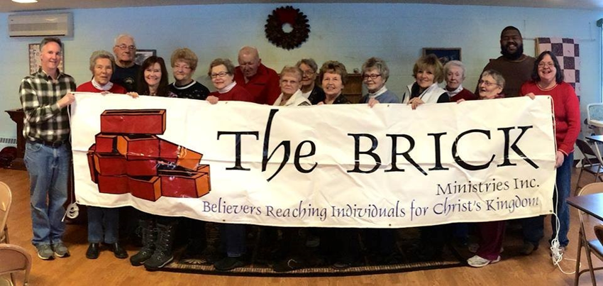
Healthy Organization Components
Healthy Board
Healthy Staff
Healthy Volunteers
Notes:
So, what does a healthy organization look like? It means healthy individuals and healthy processes. The qualities and behaviors that are markers of good health include: genuine & authentic, kind, giving, honest, ethical, integrity.
These are attributes that must be expected throughout the organization and at every level.

Slide 8
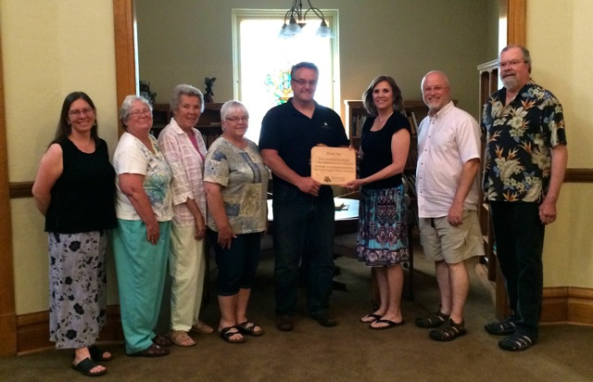
Healthy Board
  Understands its role
  Makes informed decisions
  Oversight, big picture activities
  Fiduciary duty
  Ultimate responsibility
  Target qualified candidates
  Board education
Notes:
A few things to remember – we started at the top. If the people steering your ship aren’t healthy, then you’re sunk.
Board members must:
Understand their role
Make evidence based decisions
Responsible for oversight – not day-to-day activities – that’s the staff’s responsibility
They have a fiduciary duty
They are ultimately responsible for the whole show
We get these through:
Targeting the right people
My broken record - education

Slide 9
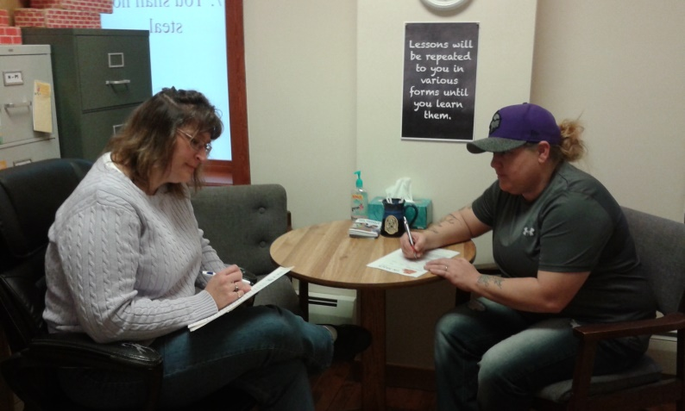
Healthy Staff
Implements best practices
Achieves results
Organization’s work culture - entitlement, fear, or quality and productivity?
Encourage personal & professional development
Notes:
Healthy staff:
Is high performing, not complacent, not entitled, and not operating out of fear.
Again – we target the right person for the job and give them the tools to do their job well. Today all four of our key staff members are here at this conference. We make sure opportunities are available through our budget, and encourage everyone to take seek out and take advantage of those opportunities.
Our board demonstrated its commitment to our staff by budgeting a thorough training program for me as a new ED and I successfully completed the Nonprofit Administration & Fund Development certificate program at UW-Superior, and now I’m working toward their HR certificate as well.

Slide 10
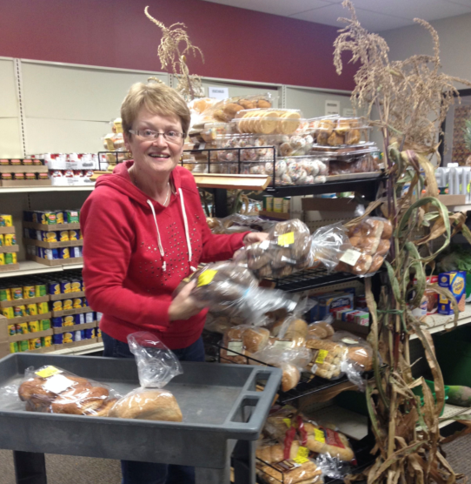
Healthy Volunteers
Deliver services with a smile
They are your face to the public
Point of entry for participants
Volunteer In-Services
Training Materials
Validated and vested
Notes:
Finally - our volunteers. We know that our volunteers do much of the work in our pantry programs. And it’s a big commitment. However we cannot let our volunteers do less and justify it by saying they’re doing so much already. We have to have high standards for our volunteers’ performance, just as we do for our paid staff. If we don’t we’re sending a message that we don’t have confidence in their abilities. We give them the responsibility of being our face to the public. They are the people who directly serve our pantry shoppers. We rely on them to provide that quality of service that makes what we offer not good, but great. It’s our responsibility to give them what they need to do their job well.

Slide 11
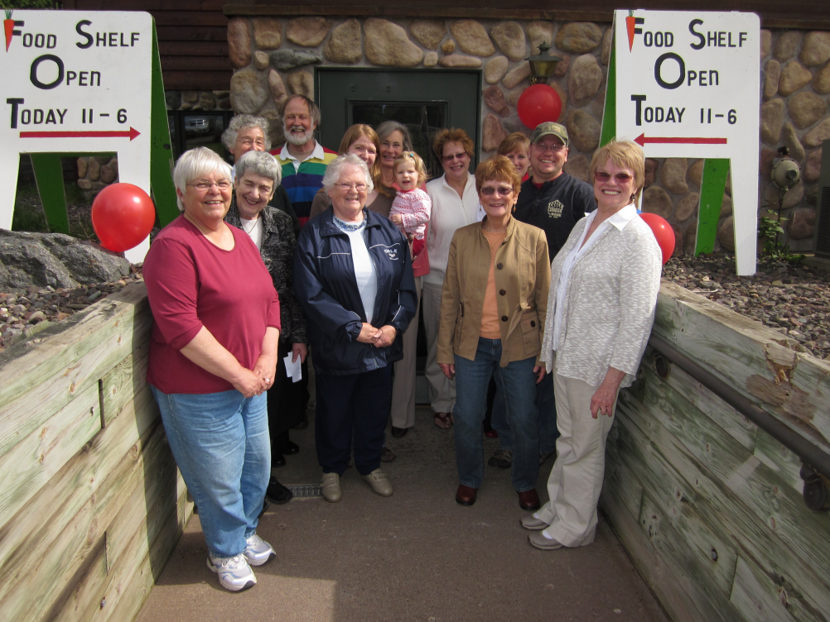
Misstep as Learning Opportunity
Identified need
Implementation takes off
Planning?
Takeaway – Say yes AND build foundations
Notes:
I have one last story to share about The BRICK’s growth and what we learned from that. I mentioned earlier that The BRICK’s food shelf program had an initial growth spurt in its first few years.
We opened three new food outlets between July 2010 and May 2011 – 10 months. Being in such a far-flung area with travel times and the cost of gas being prohibitive, representatives from congregations in Mellen, Cable and Cornucopia all were eager to open their own pantries to better serve their local residents.
These three projects were incredibly popular. The churches - and their members – with the support of The BRICK’s staff got in-kind donations of the facilities, lined up volunteers, and held food drives. Today all three pantries are important components of our food shelf program.
However, what we had in passion, we lacked in long range planning. Their stakeholders didn’t identify with The BRICK, only with those local outlets. Until recently brochures still referred to The BRICK as one of several “partners.” New volunteers at those locations weren’t always completing a volunteer application, and subsequently we weren’t always completing a background check.
So we’re having to go back and re-educate with an organization-wide identity, and the processes that are part of that package, to get everyone on the same page – again always looking at our mission and vision.
Let’s be clear – those pantries are essential for our food shelf program and for the individuals who use our services at those sites.
And – we would have done a much better job from the get-go if we’d done our pre-work.

